Slide 1
Retail Analytics in the Electronics Industry
NITHYA SRI.N

Slide 2
Overview:
This project involves a comprehensive Exploratory Data Analysis (EDA) for Global Electronics, a leading retailer in the consumer electronics industry. The goal is to extract valuable insights to enhance customer satisfaction, optimize operations, and drive overall business growth.

Slide 3
Customer Insights: Analyze demographics and purchase patterns to enhance marketing strategies.
Sales Optimization: Improve inventory management and forecasting through sales data analysis.
Product Analysis: Identify top-performing products and assess profitability.
Store Performance: Evaluate and optimize store operations based on regional performance.
Currency Impact: Assess the effect of exchange rates on international sales.

Slide 4
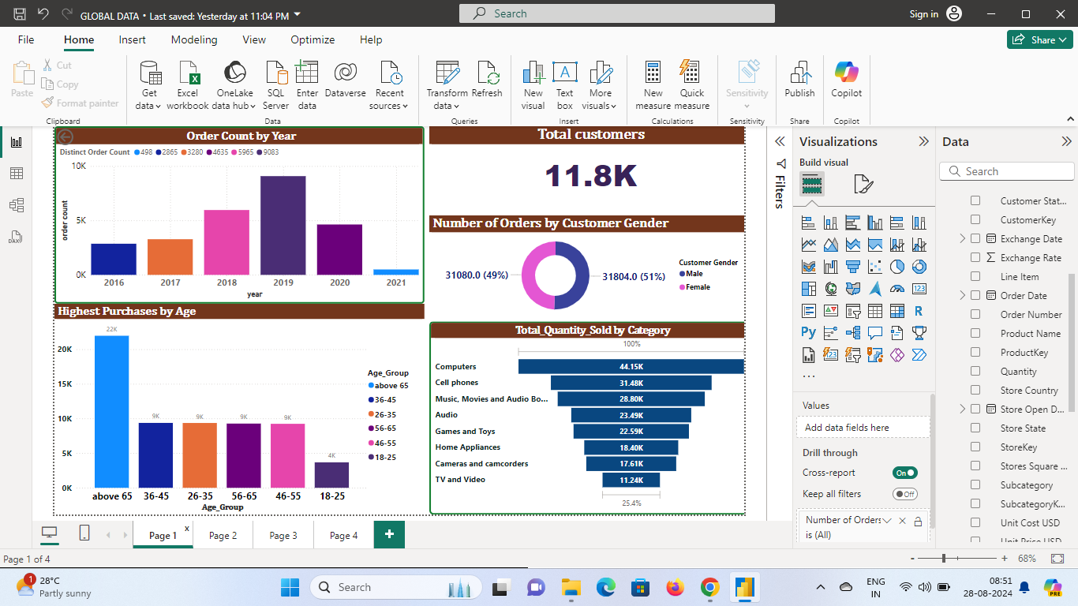

Slide 5
Number of Orders by Customer Gender (Pie Chart):
This pie chart shows the distribution of orders by customer gender.
51% of orders (31,804) are placed by females, while 49% of orders (31,080) are placed by males.
Order Count by Year (Bar Chart):
This bar chart shows the distribution of order counts across different years from 2016 to 2021.
The order counts are depicted as bars with varying heights corresponding to each year.
2020 has the highest order count, followed by 2019, while 2016 and 2021 have the lowest.
Highest Purchases by Age (Bar Chart):
This bar chart breaks down the number of purchases by different age groups.
The age group "Above 65" has the highest number of purchases (22K), followed by the "36-45" group.
Other age groups like "26-35," "56-65," "46-55," and "18-25" have lower purchase counts.
Total Quantity Sold by Category (Horizontal Bar Chart):
"Computers" have the highest quantity sold (44.15K), followed by "Cell phones" (31.48K), and "Music, Movies, and Audio Books" (28.80K).
Other categories such as "Audio," "Games and Toys," and "Home Appliances" have lower quantities sold.

Slide 6
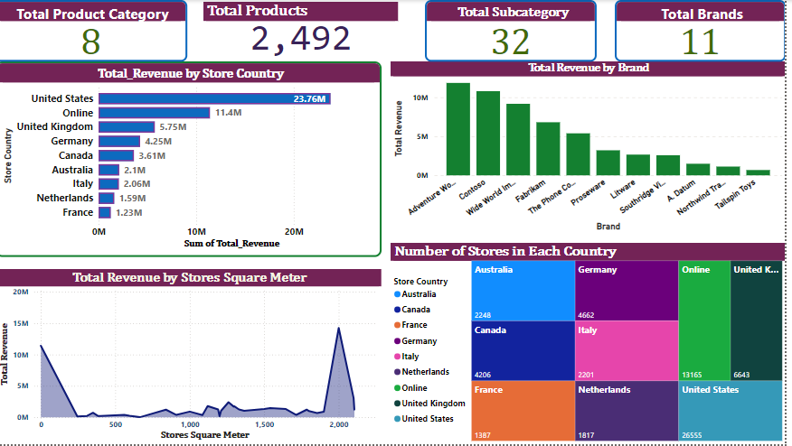

Slide 7
Total Revenue by Store Country (Horizontal Bar Chart):
This chart shows the total revenue generated by stores in different countries.
The United States leads with a revenue of 23.76M.
"Online" category which generated 11.4M.
Other countries listed include the United Kingdom, Germany, Canada, Australia, Italy, Netherlands, France.
Total Revenue by Brand (Vertical Bar Chart):
This chart shows the revenue generated by different brands.
The brand "Adventure Works" leads with the highest revenue.
Total Revenue by Stores Square Meter (Line Chart):
This chart visualizes the total revenue relative to the square meter size of stores.
It shows peaks around the 2,000 square meter mark.
Number of Stores in Each Country (Tree Map):
A tree map displays the number of stores in various countries.
The United States has the highest number of stores (26,555), followed by "Online" with 13,165.

Slide 8
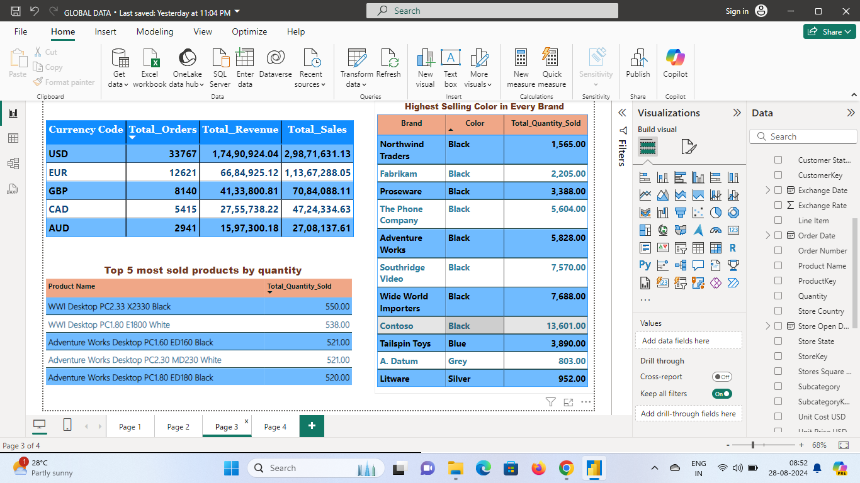

Slide 9
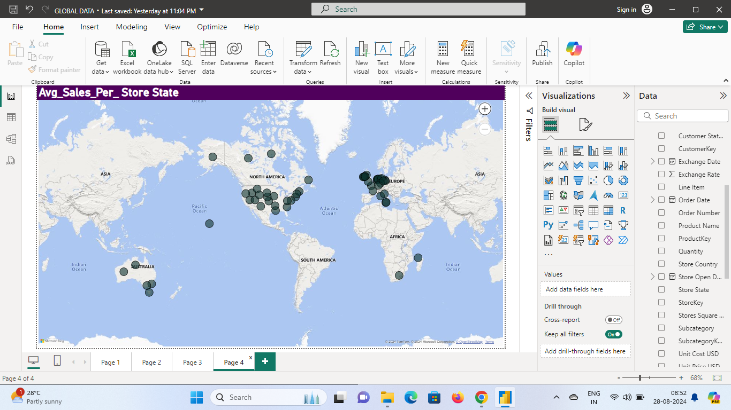

Slide 10
Conclusions and recommendations for business improvement:
Invest in High-Revenue Areas:
The U.S. and online sales are top revenue generators. Focus more resources here to boost sales even further.
Improve Underperforming Markets:
Countries like France and Italy have lower sales. Investigate why and adjust strategies to increase their performance.
Optimize Brand Performance:
Some brands are doing better than others. Study what makes the top brands successful and apply those strategies to improve weaker brands.
Right-Size Stores:
Stores around 2,000 square meters are most efficient. Consider resizing or optimizing stores to match this performance.
Expand Product and Brand Offerings:
Explore new product categories and consider adding more brands to increase market share and meet customer demand.
Grow in Potential Markets:
Countries like Australia and Canada have growth potential. Expand store presence in these regions to capture more customers.

